Slide 1


Understanding Prometheus Data Model
Prometheus is an open-source time series database focused on monitoring and alerting. It is part of Cloud Native Computing Foundation and excels in handling high-dimensional data using a pull-based scraping model.
by Arman Rasouli

Slide 2
Key Concepts: Metrics and Time Series
Metrics
Time Series
Data Points Example
Numerical measurements collected over time, representing system states or events.
Streams of timestamped data points for each metric enable trend analysis and monitoring.
http_requests_total{job="api-server",code="200"} 4523 shows accumulated requests with metadata.

Slide 3
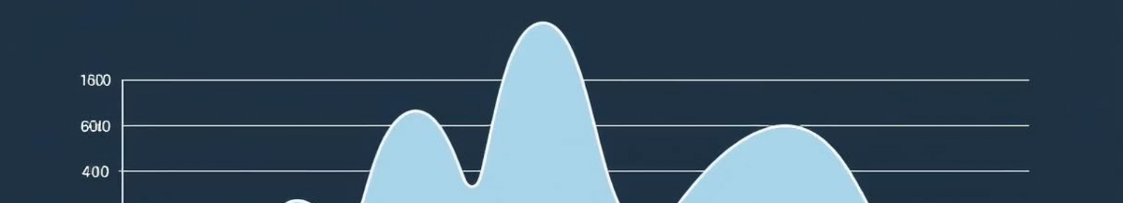
Prometheus Data Types
Counter
Gauge
Cumulative metric that only increases, like total HTTP requests.
Measures values that vary up and down, such as CPU usage percent.
Histogram
Summary
Samples event durations like request latency for detailed analysis.
Provides quantiles for request sizes, summarizing distribution.

Slide 4
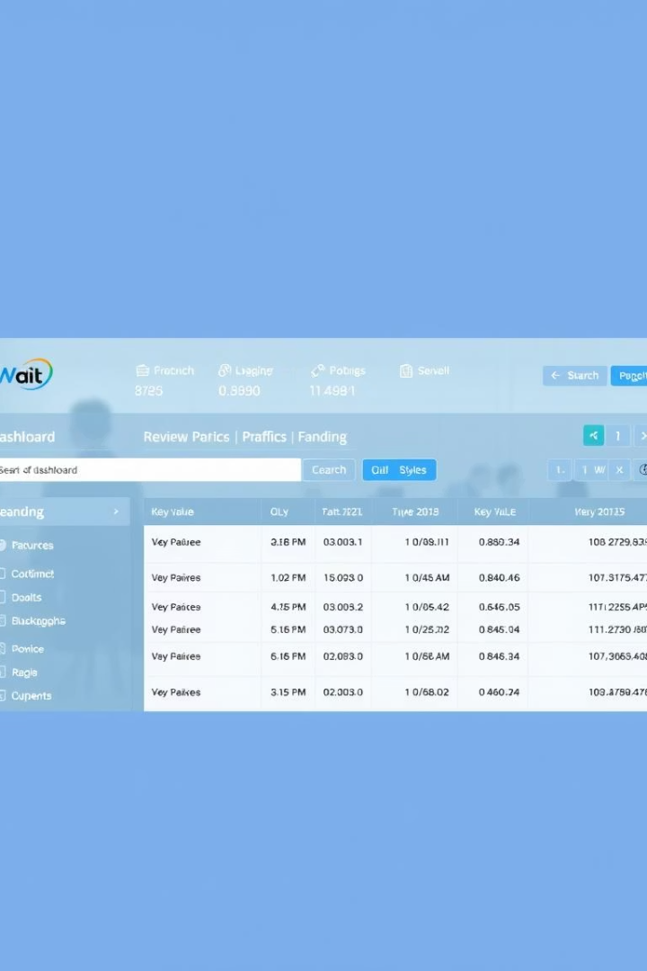
Labels: Dimensions and Identification
Labels
Dynamic Querying
Key-value pairs attached to metrics enabling multi-dimensional data insights.
PromQL utilizes labels for powerful querying and filtering of metrics.
Identification
Labels dynamically identify monitored targets and metric contexts.

